Slide 1
Hello World
Android Developer Fundamentals
Lesson 1
This work is licensed under a Creative Commons Attribution-NonCommercial 4.0 International License

Slide 2
1.2 Views, Layouts, and Resources
This work is licensed under a Creative Commons Attribution-NonCommercial 4.0 International License

Slide 3
Contents
Views, view groups, and view hierarchy
Layouts in XML and Java code
Event Handling
Resources
Screen Measurements

Slide 4
Views

Slide 5
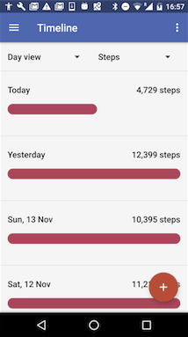
Everything you see is a view
If you look at your mobile device,
every user interface element that you see is a View.
Views

Slide 6
What is a view
Views are Android's basic user interface building blocks.
display text (TextView class), edit text (EditText class)
buttons (Button class), menus, other controls
scrollable (ScrollView, RecyclerView)
show images (ImageView)
subclass of View class

Slide 7
Views have properties
Have properties (e.g., color, dimensions, positioning)
May have focus (e.g., selected to receive user input)
May be interactive (respond to user clicks)
May be visible or not
Have relationships to other views

Slide 8
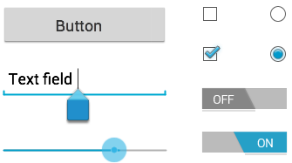
Examples of views
Button
EditText
SeekBar
CheckBox
RadioButton
Switch

Slide 9
Creating and laying out views
Graphically within Android Studio
XML Files
Programmatically

Slide 10
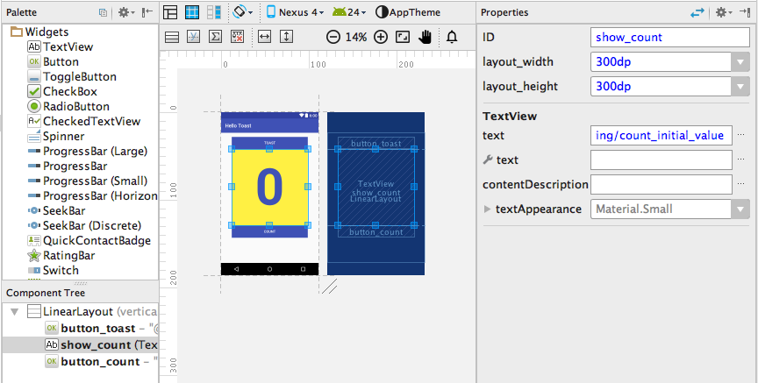
Views defined in Layout Editor
Visual representation of
what's in XML file.

Slide 11
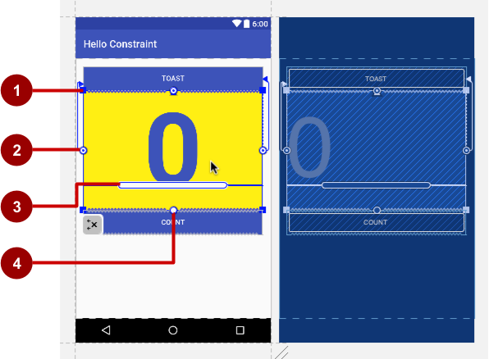
Using the Layout Editor
Resizing handle
Constraint line and handle
Baseline handle
Constraint handle

Slide 12
Views defined in XML
<TextView
android:id="@+id/show_count"
android:layout_width="match_parent"
android:layout_height="wrap_content"
android:background="@color/myBackgroundColor"
android:text="@string/count_initial_value"
android:textColor="@color/colorPrimary"
android:textSize="@dimen/count_text_size"
android:textStyle="bold"
/>

Slide 13
View properties in XML
android:<property_name>="<property_value>"
Example: android:layout_width="match_parent"
android:<property_name>="@<resource_type>/resource_id"
Example: android:text="@string/button_label_next"
android:<property_name>="@+id/view_id"
Example: android:id="@+id/show_count"

Slide 14
Create View in Java code
context
In an Activity:
TextView myText = new TextView(this);
myText.setText("Display this text!");

Slide 15
What is the context?
Context is an interface to global information about an application environment
Get the context:
Context context = getApplicationContext();
An activity is its own context: TextView myText = new TextView(this);

Slide 16
Custom views
Over 100 (!) different types of views available from the Android system, all children of the View class
If necessary, create custom views by subclassing existing views or the View class

Slide 17
ViewGroup & View Hierarchy

Slide 18
ViewGroup views
A ViewGroup (parent) is a type of view that can contain other views (children)
ViewGroup is the base class for layouts and view containers
ScrollView—scrollable view that contains one child view
LinearLayout—arrange views in horizontal/vertical row
RecyclerView—scrollable "list" of views or view groups

Slide 19
Hierarchy of view groups and views
ViewGroup
Root view is always a view group
ViewGroup
View
View
View
View
View

Slide 20
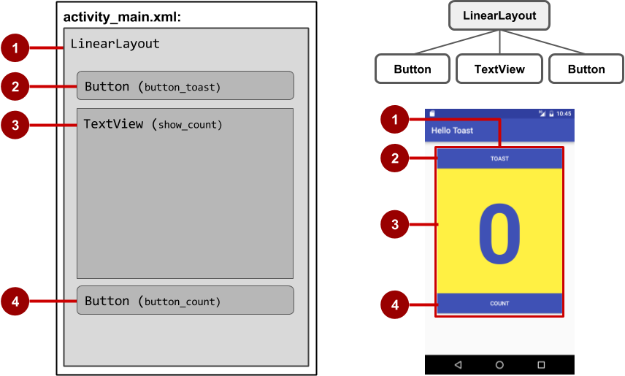
View hierarchy and screen layout

Slide 21
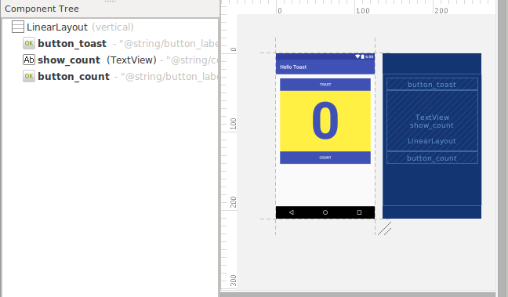
View hierarchy in the component tree

Slide 22
Best practices for view hierarchies
Arrangement of view hierarchy affects app performance
Use smallest number of simplest views possible
Keep the hierarchy flat—limit nesting of views and view groups

Slide 23
Layouts

Slide 24
Layout Views
Layouts
are specific types of view groups
are subclasses of ViewGroup
contain child views
can be in a row, column, grid, table, absolute

Slide 25




Common Layout Classes
LinearLayout
RelativeLayout
GridLayout
TableLayout

Slide 26
Common Layout Classes
ConstraintLayout - connect views with constraints
LinearLayout - horizontal or vertical row
RelativeLayout - child views relative to each other
TableLayout - rows and columns
FrameLayout - shows one child of a stack of children
GridView - 2D scrollable grid

Slide 27
Class Hierarchy vs. Layout Hierarchy
View class-hierarchy is standard object-oriented class inheritance
For example, Button is-a TextView is-a View is-a Object
Superclass-subclass relationship
Layout hierarchy is how Views are visually arranged
For example, LinearLayout can contain Buttons arranged in a row
Parent-child relationship

Slide 28
Layout created in XML
<LinearLayout
android:orientation="vertical"
android:layout_width="match_parent"
android:layout_height="match_parent">
<EditText
... />
<Button
... />
</LinearLayout

Slide 29
Layout created in Java Activity code
LinearLayout linearL = new LinearLayout(this);
linearL.setOrientation(LinearLayout.VERTICAL);
TextView myText = new TextView(this);
myText.setText("Display this text!");
linearL.addView(myText);
setContentView(linearL);

Slide 30
Setting width and height in Java code
Set the width and height of a view:
LinearLayout.LayoutParams layoutParams =
new Linear.LayoutParams(
LayoutParams.MATCH_PARENT, LayoutParams.WRAP_CONTENT);
myView.setLayoutParams(layoutParams);

Slide 31
Event Handling

Slide 32
Events
Something that happens
In UI: Click, tap, drag
Device: DetectedActivity such as walking, driving, tilting
Events are "noticed" by the Android system

Slide 33
Event Handlers
Methods that do something in response to a click
A method, called an event handler, is triggered by a specific event and does something in response to the event

Slide 34
Handling clicks in XML & Java
Attach handler to view in layout:
android:onClick="showToast"
Implement handler in activity:
public void showToast(View view) {
String msg = "Hello Toast!";
Toast toast = Toast.makeText(
this, msg, duration);
toast.show();
}
}

Slide 35
Setting click handlers in Java
final Button button = (Button) findViewById(R.id.button_id);
button.setOnClickListener(new View.OnClickListener() {
public void onClick(View v) {
String msg = "Hello Toast!";
Toast toast = Toast.makeText(this, msg, duration);
toast.show();
}
});

Slide 36
Resources

Slide 37
Resources
Separate static data from code in your layouts.
Strings, dimensions, images, menu text, colors, styles
Useful for localization

Slide 38
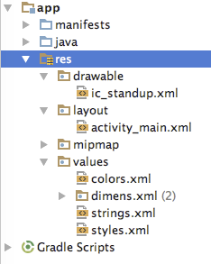
Where are the resources in your project?
resources and resource files
stored in res folder

Slide 39
Refer to resources in code
Layout:
R.layout.activity_main
setContentView(R.layout.activity_main);
View:
R.id.recyclerview
rv = (RecyclerView) findViewById(R.id.recyclerview);
String:
In Java: R.string.title
In XML: android:text="@string/title"

Slide 40
Measurements
Device Independent Pixels (dp) - for Views
Scale Independent Pixels (sp) - for text
Don't use device-dependent units:
Actual Pixels (px)
Actual Measurement (in, mm)
Points - typography 1/72 inch (pt)
Notes:
On measurements that you should use for your dimensions.
Device independent pixels are independent of screen resolution.
For example, 10px will look a lot smaller on a higher resolution screen, but Android will scale 10dp to look right on different resolution screens.
SP does the same for text size.

Slide 41
Learn more

Slide 42
Learn more
Views:
View class documentation
device independent pixels
Button class documentation
TextView class documentation
Hierarchy Viewer for visualizing the view hierarchy
Layouts:
developer.android.com Layouts
Common Layout Objects

Slide 43
Learn even more
Resources:
Android resources
Color class definition
R.color resources
Supporting Different Densities
Color Hex Color Codes
Other:
Android Studio documentation
Image Asset Studio
UI Overview
Vocabulary words and concepts glossary
Model-View-Presenter (MVP) architecture pattern
Architectural patterns

Slide 44
What's Next?
Concept Chapter: 1.2 C Layouts, Views, and Resources
Practicals:
1.2A P Make Your First Interactive UI
1.2B P Using Layouts

Slide 45
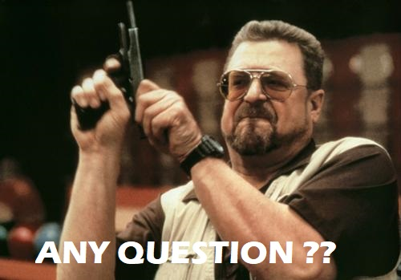

Slide 46
Reminder
Buka menti.com
Masukan kode 585988
Isi sesuai dengan hati nurani yang paling dalam
Let’s See

Slide 47
END
You Can’t trust code that you did not totally create yourself

